Slide 1

BRIDGING ROBOTICS AND NUCLEAR SAFETY WITH DIGITAL TWINS
SAINTGITS
COLLEGE OF ENGINEERING
(AUTONOMOUS)
Seminar Guide
Dr. Binson V A
Associate Professor
Presented by
Febina Sara Sam (MGP22URB041)
Department of Electronics Engineering
SAINTGITS College of Engineering
LEARN . GROW . EXCEL

Slide 2

Contents
Introduction
Why Robotics in NPP?
Digital Twin Concept
System Architecture
Methodology
Process Flow Diagram
Future Scope
Conclusion
References
LEARN . GROW . EXCEL

Slide 3
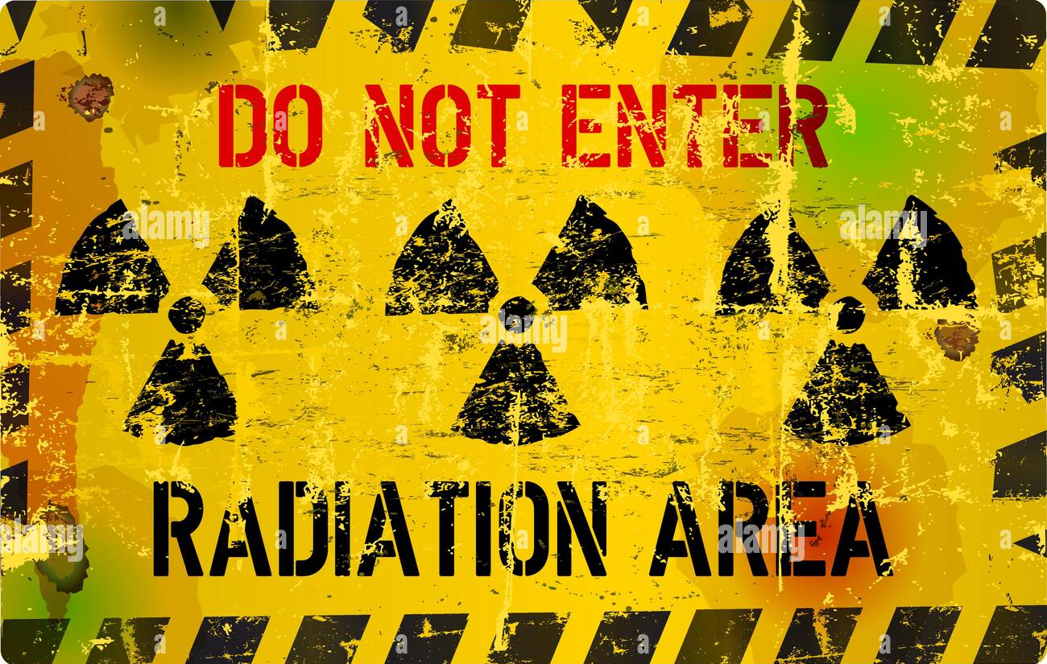

Introduction
Nuclear power plants (NPPs) operate in environments that are often unsafe for prolonged human presence due to extreme temperatures and harmful radiation.
An effective approach is provided by robotics, however, testing new robotic systems directly in operating NPPs is extremely difficult due to safety and regulatory restrictions.
A digital twin, a virtual replica of the plant provides a realistic, risk-free environment for developing, testing, and optimizing robotic operations. This seminar explores the integration of the GPWR simulator with the Omniverse-ROS platform to create an advanced NPP digital twin for navigation and interaction research.
LEARN . GROW . EXCEL

Slide 4
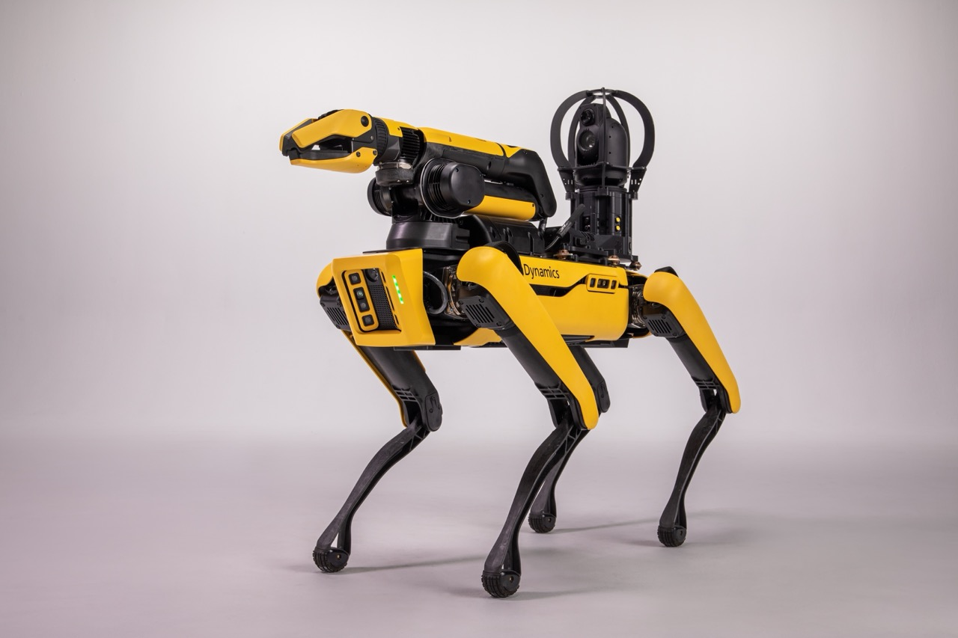
Why Robotics in NPP?
Robotics in Nuclear Power Plants offer:
Avoids exceeding NRC’s annual radiation exposure limit of 50 mSv.
Reduces manpower needs in hazardous plant areas.
Minimizes human exposure to heat, radiation, and contamination.
Allows maintenance without shutting down the plant.
Delivers precise and reliable operation without fatigue.
Enables inspection and recovery after accidents.
Boston Dynamics Spot
LEARN . GROW . EXCEL

Slide 5
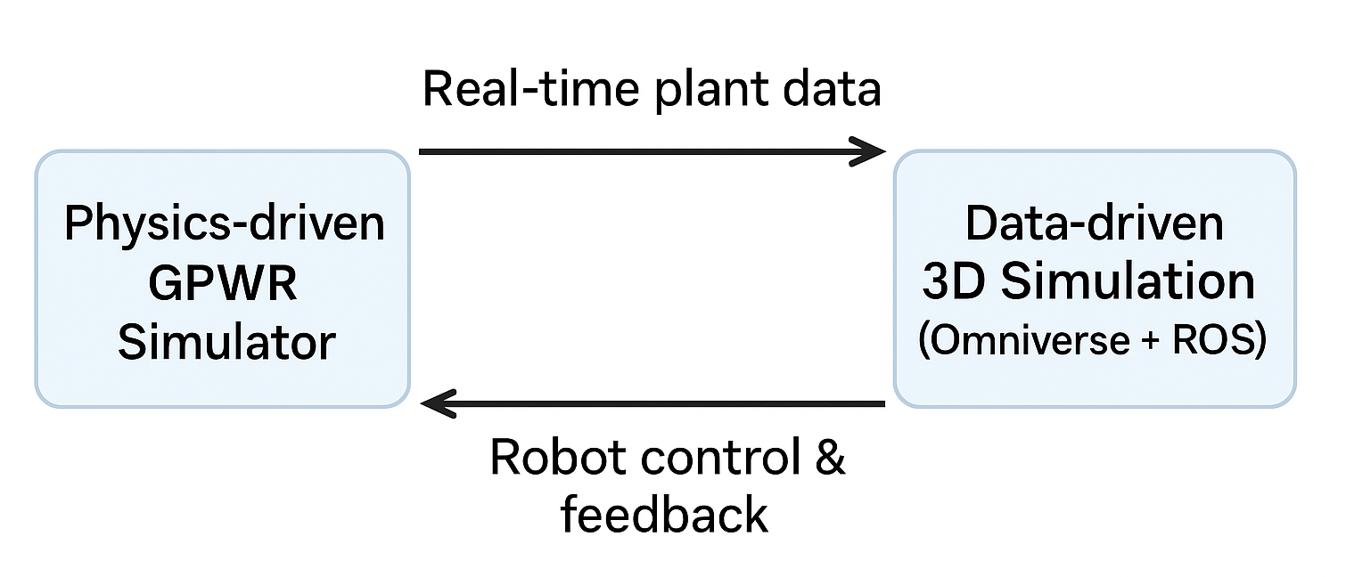
Digital Twin Concept
A Digital Twin is a virtual representation of a physical system that mirrors its state and behavior in real time. It can be implemented in different forms depending on the application.
Types of Digital Twins :
Physics-driven - Based on fundamental physical laws and system equations.
Data-driven - Based on real-time or simulated sensor data
System
LEARN . GROW . EXCEL

Slide 6
System Architecture
Digital twin in NPPs have 3 parts :
Example: Georgia Tech research linking GPWR simulator + Omniverse + ROS
Plant Simulator : Creates plant data (temperature pressure, flow).
3D Simulation Platform : Environments where robots navigate.
Middleware (eg, ROS) : Connects robots to plant data.
System
LEARN . GROW . EXCEL

Slide 7
Methodology
(i) Data Projection :
A simulator can be used as a substitute for real NPP data due to access restrictions.
Process flow will be as follows:
GUI-based simulator generates plant operation data.
Real-time sensor readings extracted using interface tools like DDE.
Target sensors listed in a configuration file for selective data capture.
Data transmitted via protocols like TCP/IP to the 3D simulation.
Sent in key:value pair format with timestamps for efficiency.
Published as custom ROS messages for robot integration
LEARN . GROW . EXCEL

Slide 8
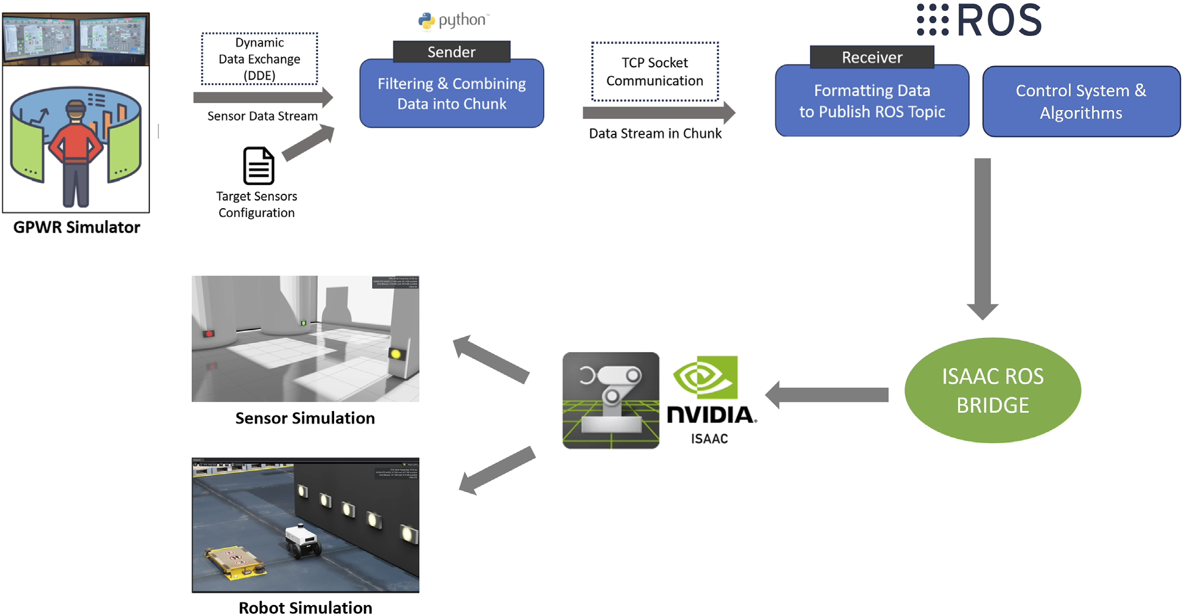
Example :
LEARN . GROW . EXCEL

Slide 9
Process Flow Diagram
Commands & Status
Robot Controllers: Navigation, Inspection & Planning
GPWR Simulator (Client): Runs in Win32 env; GUI + DDE support
Sensor Data: key:value format
3D Simulation (Server): Omniverse Isaac Sim
DDE Protocol
ROS Integration
(Isaac ROS Bridge)
TCP/IP Transmission (byte stream) Separator: ":" between key & value "|" between pairs
LEARN . GROW . EXCEL

Slide 10
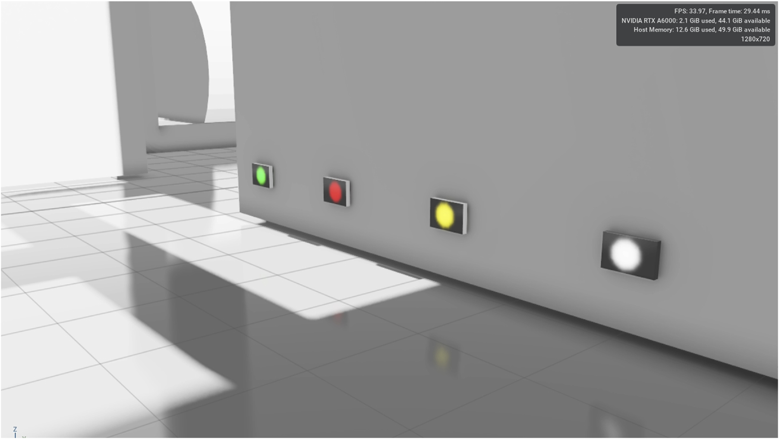
(ii)Sensor Model
There are four operating conditions as per NRC guidelines:
  Green: Healthy, within expected performance.
  White: Healthy, outside expected range.
  Yellow: Healthy, reduced safety margin.
  Red: Unhealthy
LEARN . GROW . EXCEL

Slide 11
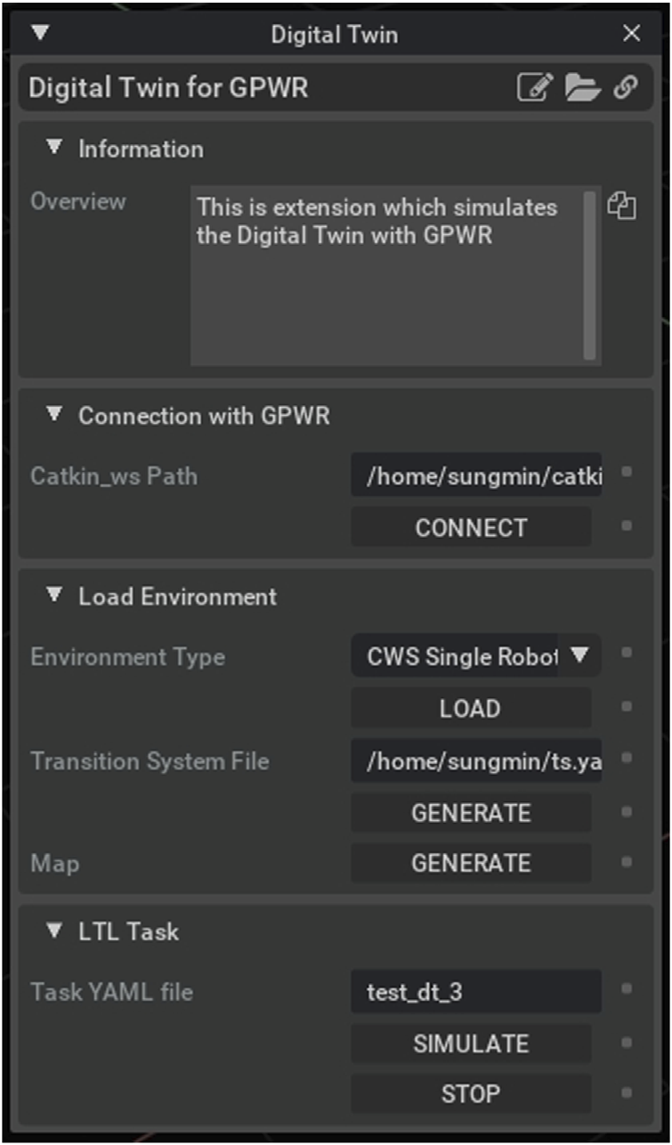
(iii)Improved Collaboration
The developed DT components can be packaged as a ready-to-use simulation extension.
The developed extension provides two benefits:
First, it lowers huddles for the new collaborators to get started with.
Secondly, it allows the developers to deploy the application easily
LEARN . GROW . EXCEL

Slide 12
(iv) LTL Planning
Tasks are written as LTL formulas, which describe constraints on robot behavior. LTL uses temporal operators such as :
G (Globally): something must always be true.
F (Eventually): something must happen at least once.
X (Next): something must be true in the next step.
U (Until): one condition must hold until another becomes true.
Example: “Eventually visit all sensors” → F(sensor1 ∧ sensor2 ∧ sensor3)
“Always avoid radiation zone” → G(¬zoneZ)
LEARN . GROW . EXCEL

Slide 13
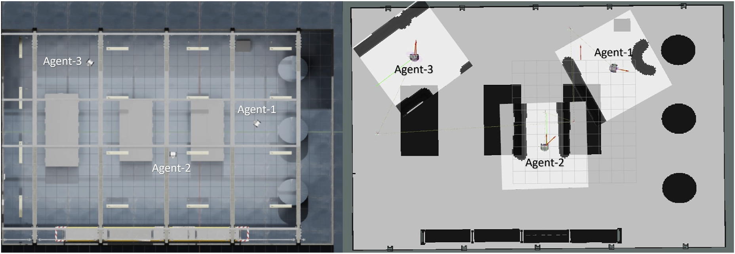
Example : Demo of LTL Planning using Multi Robots in action
(Left) Issac Sim and (Right) RVIZ
LEARN . GROW . EXCEL

Slide 14
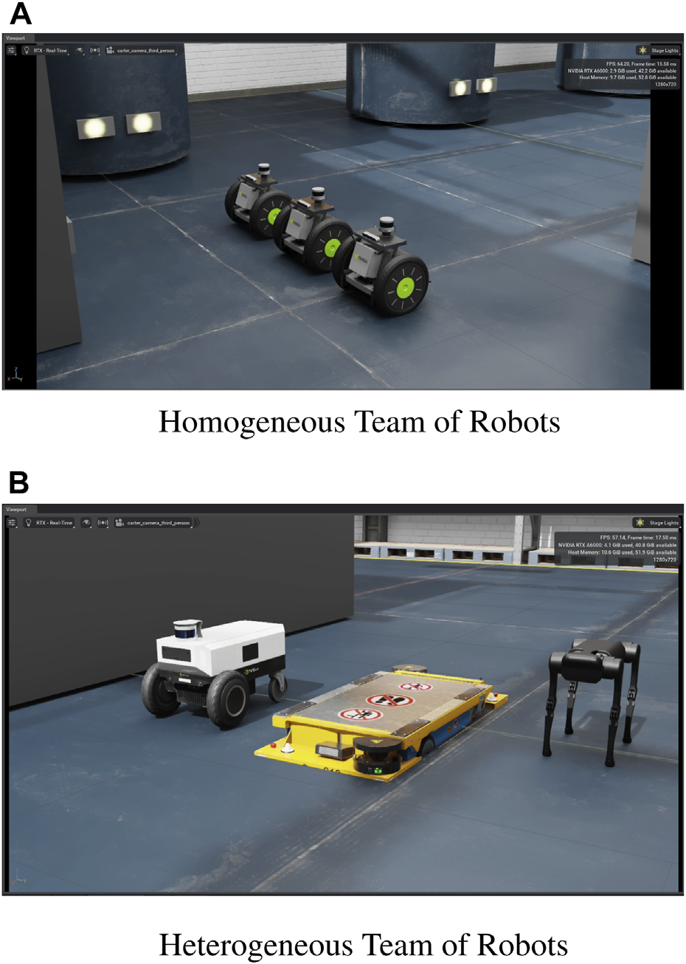
(v) Seamless Robot Integration
Homogeneous team: Same robot type (e.g., Carter v1).
Heterogeneous team: Mixed robots (Carter v2, STR, Unitree A1).
Tests adaptability to different robot capabilities.
LEARN . GROW . EXCEL

Slide 15
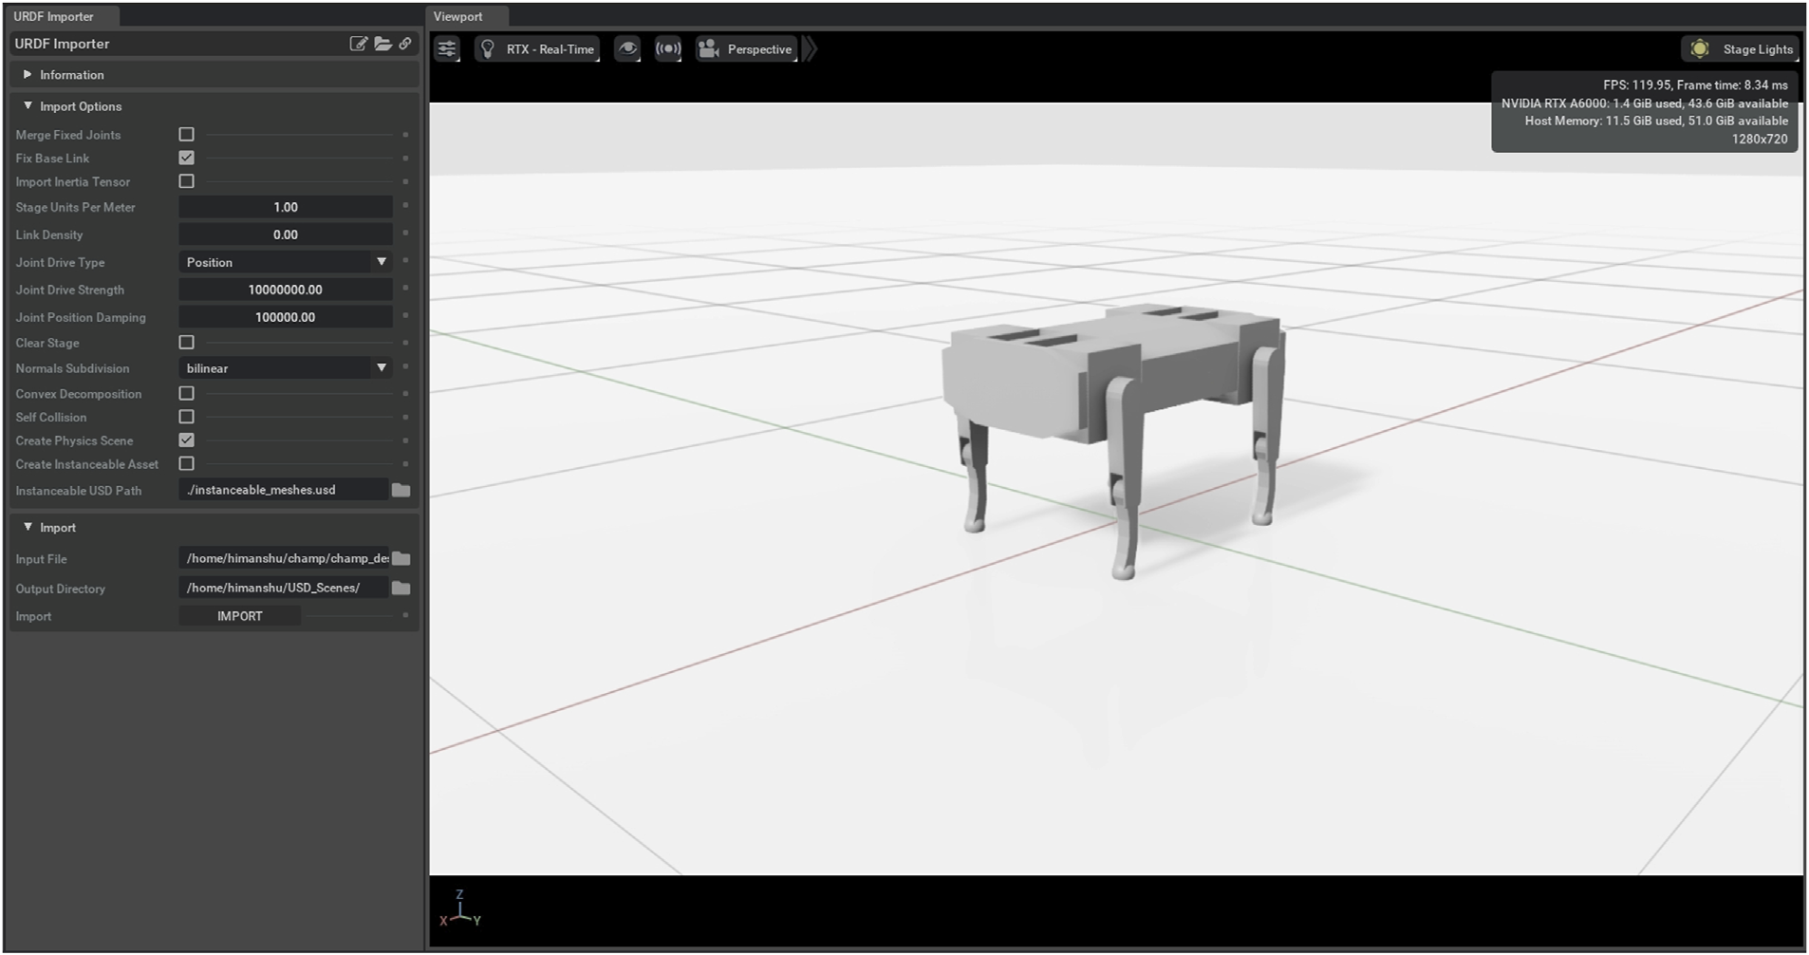
(vi) Custom Robot Import
Demonstrates importing custom robots into simulation.
Supports adding new robot designs easily.
LEARN . GROW . EXCEL

Slide 16
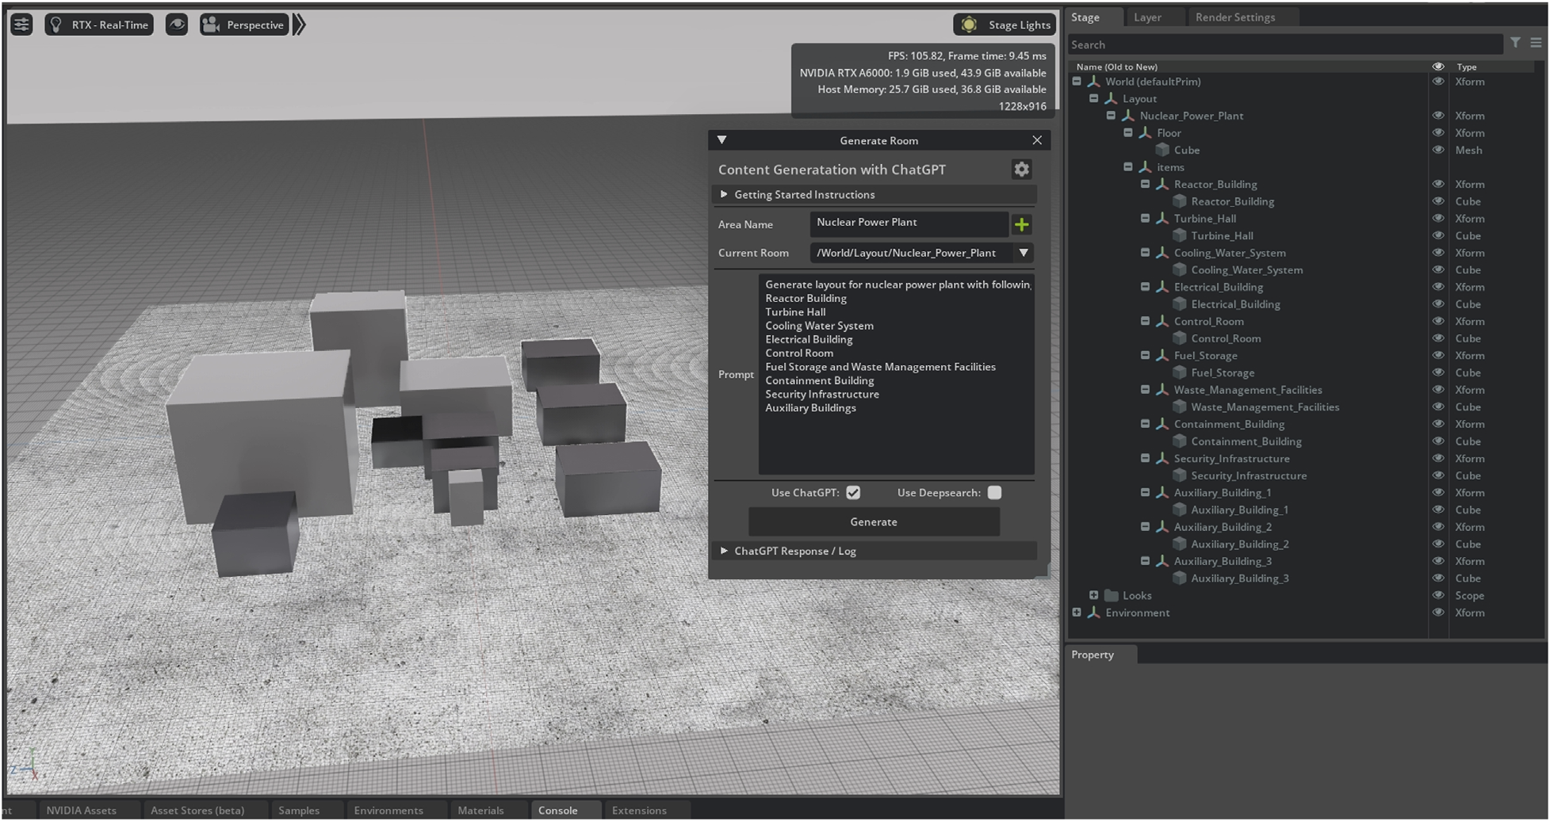
(vii) AI-Generated Plant Models
LEARN . GROW . EXCEL

Slide 17
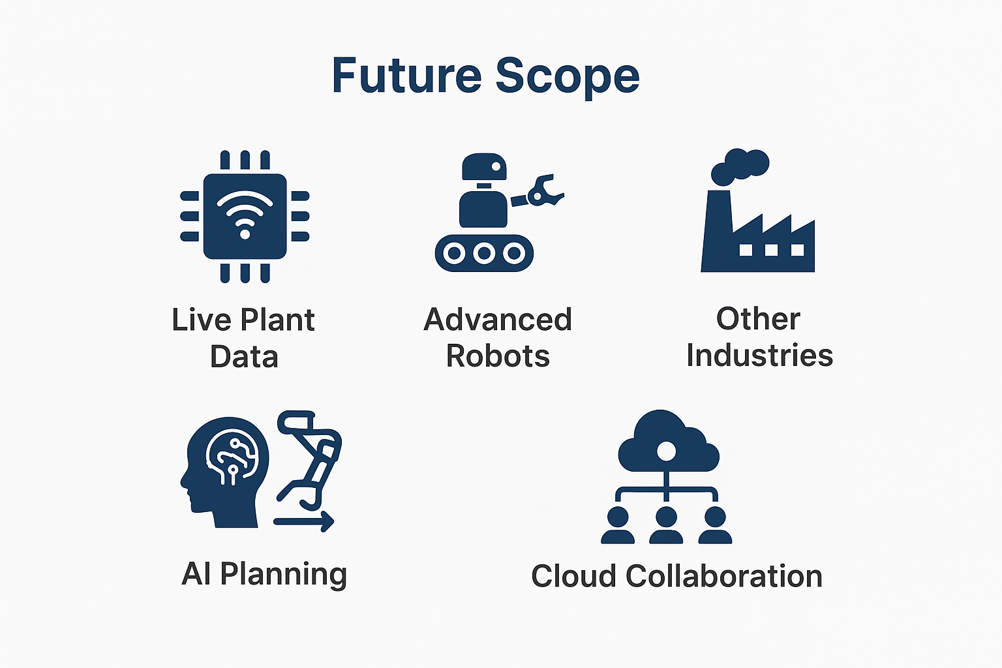
Future Scope
LEARN . GROW . EXCEL

Slide 18
Conclusion
Robotics and digital twin integration enables safe, efficient, and realistic testing of nuclear plant operations without risking human safety.
Key Takeaways:
Reduces human exposure while improving precision and operational efficiency.
Supports research, training, and planning for safer, smarter, and more sustainable NPPs.
LEARN . GROW . EXCEL

Slide 19
References
[1]Vairagade, H., Kim, S., Son, H., & Zhang, F. (2024). A nuclear power plant digital twin for developing robot navigation and interaction. Frontiers in Energy Research, 12, 1356624.
[2]Kochunas, B., & Huan, X. (2021). Digital twin concepts with uncertainty for nuclear power applications. Energies, 14(14), 4235.
[3]Bowman, D., Dwyer, L., Levers, A., Patterson, E. A., Purdie, S., & Vikhorev, K. (2022). A unified approach to digital twin architecture—proof-of-concept activity in the nuclear sector. Ieee Access, 10, 44691-44709.
[4]Ritter, C., Hays, R., Browning, J., Stewart, R., Bays, S., Reyes, G., ... & Zohner, P. (2022). Digital twin to detect nuclear proliferation: A case study. Journal of Energy Resources Technology, 144(10), 102108.
[5]Mondal, K., Martinez, O., & Jain, P. (2024). Advanced manufacturing and digital twin technology for nuclear energy. Frontiers in Energy Research, 12, 1339836.
[6]Mazumder, A., Sahed, M. F., Tasneem, Z., Das, P., Badal, F. R., Ali, M. F., ... & Islam, M. R. (2023). Towards next generation digital twin in robotics: Trends, scopes, challenges, and future. Heliyon, 9(2).
[7]Kang, R., Dong, Z., & He, J. (2024, July). Digital twin for mobile robot modeling and simulation. In Journal of Physics: Conference Series (Vol. 2803, No. 1, p. 012060). IOP Publishing.
[8]Baniqued, P. D. E., Bremner, P., Sandison, M., Harper, S., Agrawal, S., Bolarinwa, J., ... & Watson, S. (2024). Multimodal immersive digital twin platform for cyber–physical robot fleets in nuclear environments. Journal of field robotics, 41(5), 1521-1540.
[9]Sharma, U., Medasetti, U. S., Deemyad, T., Mashal, M., & Yadav, V. (2024). Mobile robot for security applications in remotely operated advanced reactors. Applied Sciences, 14(6), 2552.
[10]Nambiar, S., Jonsson, M., & Tarkian, M. (2024). Automation in unstructured production environments using isaac sim: A flexible framework for dynamic robot adaptability. Procedia CIRP, 130, 837-846.

Slide 20
[11]Heluany, J. B., & Gkioulos, V. (2024). A review on digital twins for power generation and distribution. International Journalof Information Security, 23(2), 1171-1195.
[12]Jang, K. B., Baek, C. H., & Woo, T. H. (2022). Risk analysis of nuclear power plant (NPP) operations by artificial intelligence (AI) in robot. Journal of Robotics and Control (JRC), 3(2), 153-159
[13]Zeb, A., Kokkonen, P., Tahkola, M., Brace, W., & Milella, F. (2025). Advancing remote handling capabilSingh, M., Srivastava, R., Fuenmayor, E., Kuts, V., Qiao, Y., Murray, N., & Devine, D. (2022). Applications of digital twin across industries: A review. Applied Sciences, 12(11), 5727.ities in the nuclear industry with AI-based surrogate models for robotic technologies. Fusion Engineering and Design, 219, 115286.
[14]Do, Y., Zebrowitz, M., Stahl, J., & Zhang, F. (2024). iFANnpp: Nuclear Power Plant Digital Twin for Robots and Autonomous Intelligence. arXiv preprint arXiv:2410.09213.
[15]Singh, M., Srivastava, R., Fuenmayor, E., Kuts, V., Qiao, Y., Murray, N., & Devine, D. (2022). Applications of digital twin across industries: A review. Applied Sciences, 12(11), 5727.
[16]Javaid, M., Haleem, A., & Suman, R. (2023). Digital twin applications toward industry 4.0: A review. Cognitive Robotics, 3, 71-92.
[17]Bhatia, N., Costa, R., Pamela, S. J., Davis, A., Gonzalez Beltran, A. N., Gopakumar, V., ... & Akers, R. (2025). Visualizing digital twins of fusion power plants using NVIDIA Omniverse. AIP Advances, 15(4).
[18]Battye, M. I., & Perinpanayagam, S. (2025). Digital Twins in Fusion Energy Research: Current State and Future Directions. IEEE Access.
[19]Park, S. Y., Lee, C., Jeong, S., Lee, J., Kim, D., Jang, Y., ... & Ahn, S. H. (2024). Digital twin and deep reinforcement learning-driven robotic automation system for confined workspaces: A nozzle dam replacement case study in nuclear power plants. International Journal of Precision Engineering and Manufacturing-Green Technology, 11(3), 939-962.
[20]Guo, J., & Lv, Z. (2022). Application of Digital Twins in multiple fields. Multimedia tools and applications, 81(19), 26941-26967.

